Slide 1

Fake News Detection using Artificial Intelligence Practicum II Project Improvement Presentation
Student: Ashok Jana Course: Practicum II
Regis University

Slide 2
Introduction
Due to Rapid growth of digital media information is spreading quickly
Along with that fake news is also spreading Fastly
Effects
People’s opinions
Elections
Economy and society
Goal is to Develop a system which can Detect fake news automatically
In my project I Used ML models and BERT model to classify news as real or fake
Problem Statement : Huge amount of information is generating daily . It is very hard to manually verify every news article, and more over manual checking is slow and not scalable. So, detecting fake news accurately is still a challenge .

Slide 3
Dataset Generation Pipeline
How Dataset Was Generated
The dataset generation process was fully automated using Python pipelines.
Pipeline Process
Web scraping
HTML parsing
Article extraction
Data cleaning
Duplicate filtering
Feature generation
Dataset validation
Train/test splitting
Real News Sources
BBC News
Associated Press (AP)
NPR
The Guardian
Fake News Sources
PolitiFact
Snopes
FullFact
Lead Stories
Final Dataset Structure
Dataset Records
Full Dataset 20771
Training Dataset 16617
Testing Dataset 4154

Slide 4
Data Cleaning
Perform lowercase normalization
Removed URL’s
Removed HTML tags
Removed punctuations
Removed numbers
Removed extra whitespaces
Stopword filtering

Slide 5
Feature Engineering
Word Count - Measures article complexity
Text Length - Analyzes content density
Capitalization Ratio - Detects emotional emphasis
Punctuation Frequency - Detects sensational writing patterns
TF-IDF Features - Used TF-IDF feature to convert text into numerical form so that the machine learning models can be able to understand and train easily

Slide 6
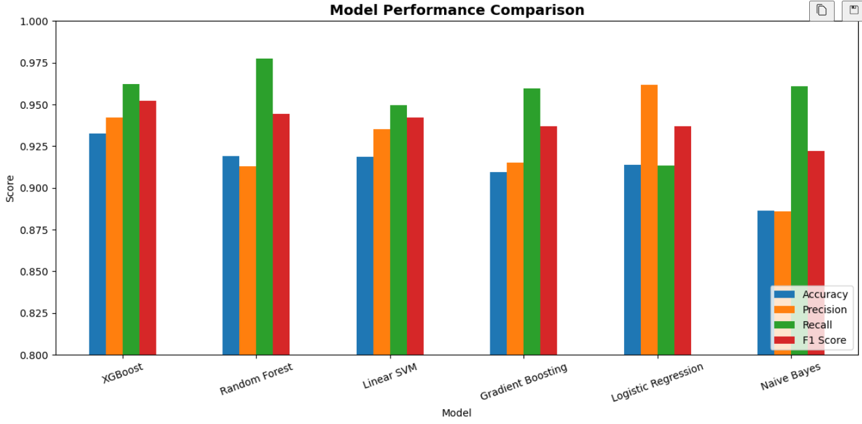
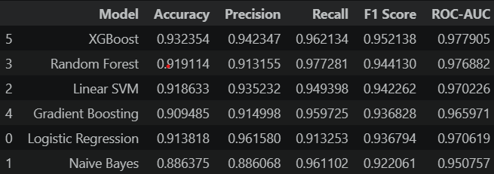
Machine learning Models
Results
Model Comparison

Slide 7
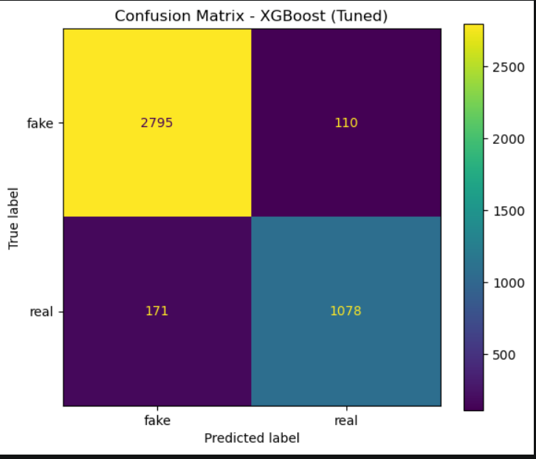
Hyperparameter Tuning
Performed hyperparameter tuning for all the base models by adjusting their parameters Ex : n_estimators , max_depth , learning rate
Best Model : XGBoost achieved the best overall performance after tuning with accuracy

Slide 8
BERT Model
I my project I have used DistilBert a pre-trained transformer model, to capture contextual meaning from news articles.
Tokenized and converted text into contextual embeddings using the DistilBERT tokenize
Fine-tuned the model on the collected fake and real news dataset for classification.
At the end BERT Outperformed all traditional machine learning models

Slide 9
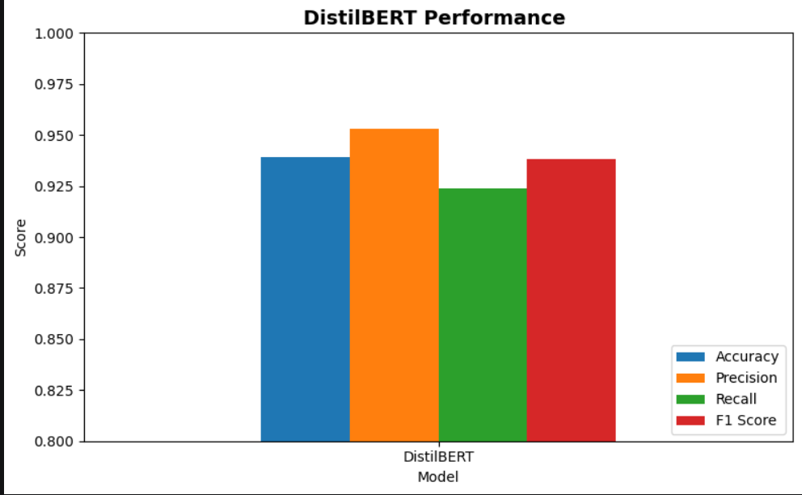
BERT Results
Achieved 94.93% Accuracy, 93.43% Precision, 96.67% Recall, and 95.02% F1 Score.
Achieved a ROC-AUC score of 98.66%, indicating excellent classification capability.

Slide 10
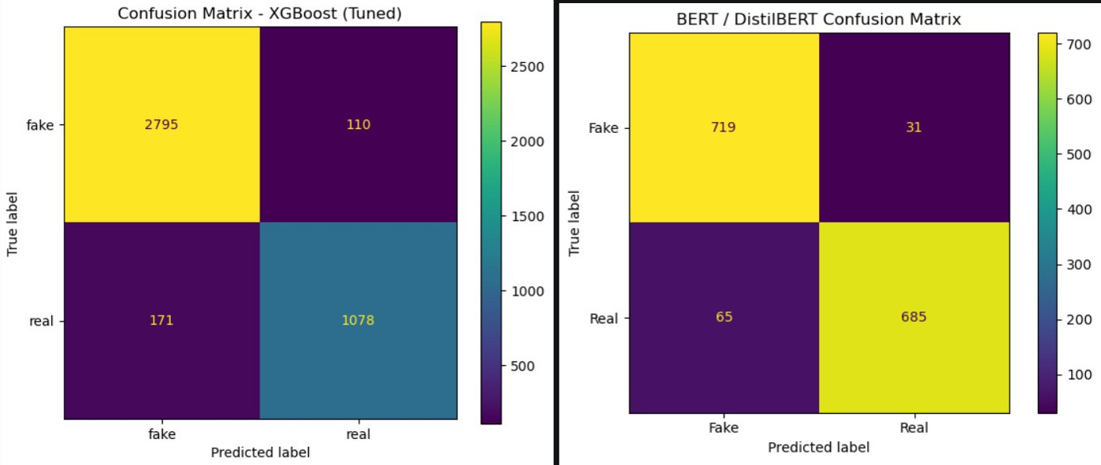
Best Models
XGBoost and BERT were the best models for classifying Fake news

Slide 11
Conclusion
At the Developed an end-to-end fake news detection system using Artificial Intelligence Techniques
Collected and processed 20,771 news articles from multiple trusted news and fact-checking sources.
Applied text preprocessing, feature engineering, TF-IDF vectorization, and model evaluation techniques.
Compared six machine learning models, with XGBoost achieving the strongest performance among traditional ML models.
DistilBERT achieved the highest overall performance by capturing contextual and semantic relationships within news articles.

Slide 12
Thank you

